Slide 1
Genre-based lyric generation: a tool for songwriters
Ange Olson
M.S. Data Science Capstone, George Washington University
May 3, 2023

Slide 2
Agenda
Intro: Project Objectives and Overview
Methodology:
Data Preprocessing and EDA
Bi-gram model and a Markov Process
Long Short-Term Memory Modeling:
GloVe embeddings and stacked layers
Transfer learning: BERT final hidden layer as embeddings
Results
Evaluation:
Metric comparison to artist-written songs
Informal survey results
Progress towards objectives

Slide 3
Intro
Background: AI generation as an aid to creators, not replacement
Goal: to develop a lyric generator that can aid songwriters, particularly those working independently and in the “indie” genre of music
Objective I: The model can generate realistic-sounding lyrics in comprehendible English with minimal editing
Objective II: The generated songs fit within structures of a song, i.e. have verses, choruses, etc.
Objective III: The words and tone of the songs fit with the rest of the indie-rock genre
Objective IV: It can be argued that the lyrics create a narrative, i.e. lines in the song relate as much as much as other songs in this genre
Notes:
Wired article: digital artists are using AI to act as a source of inspiration, Rolling Stone article about the lack of single songwriters in the top charts

Slide 4


Methodology: Data Pre-Processing
Sources: Million Song Dataset last.fm component, Genius.com
Process:
Filter indie songs
Pull song lyrics
Break into components (lines, songbreaks)
Clean text, add special tokens
Result: 2867 songs
Notes:
Cleaning text: lowercasing, removing characters, removing non-English songs, contractions, choosing what punctuation to keep in.

Slide 5
Methodology: EDA
Purpose: inform data cleaning and which statistics can be used to evaluate model performance

Slide 6
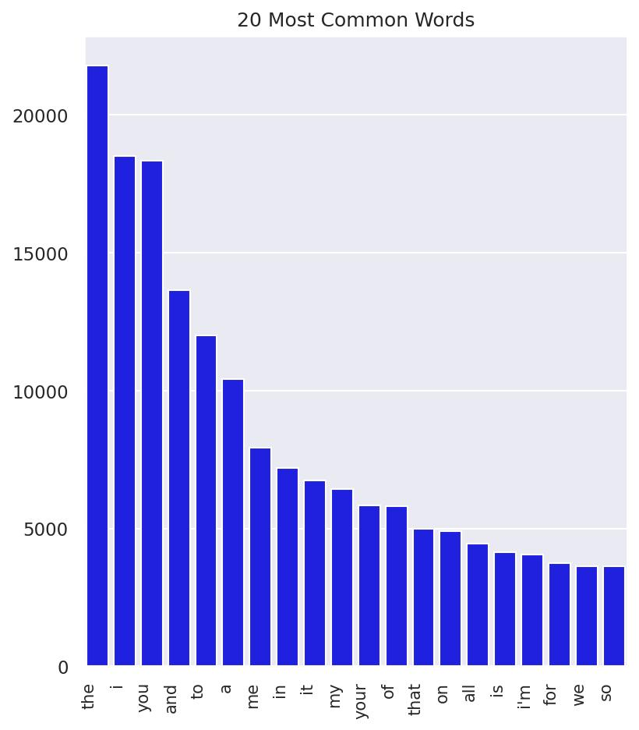
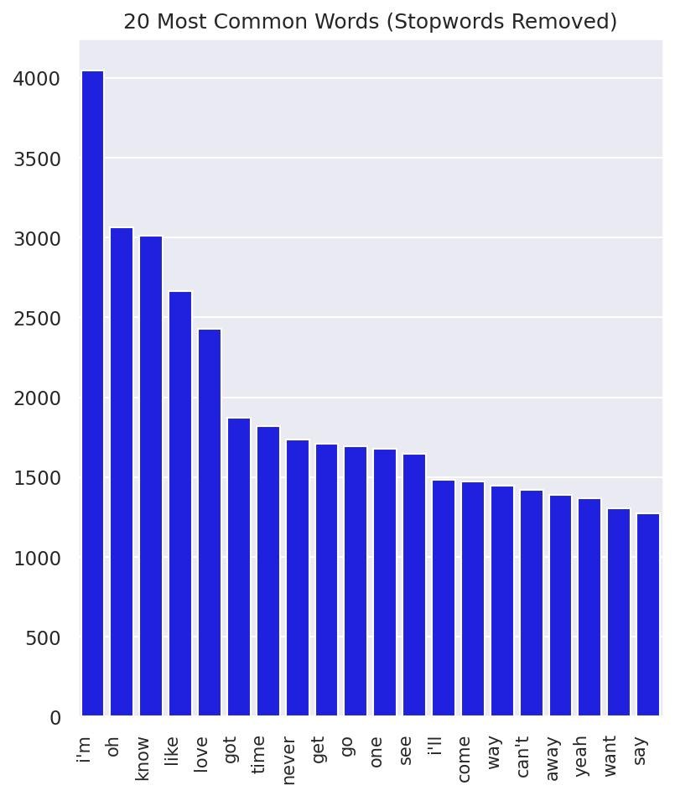
N = 2867

Slide 7
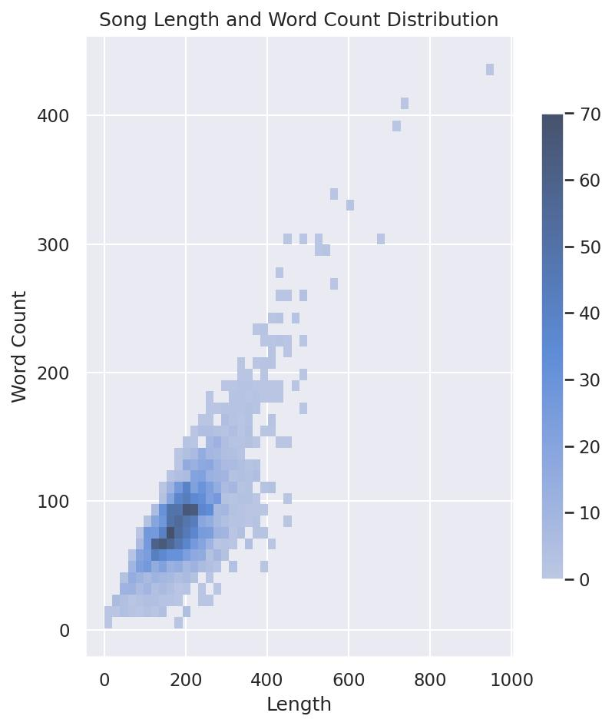
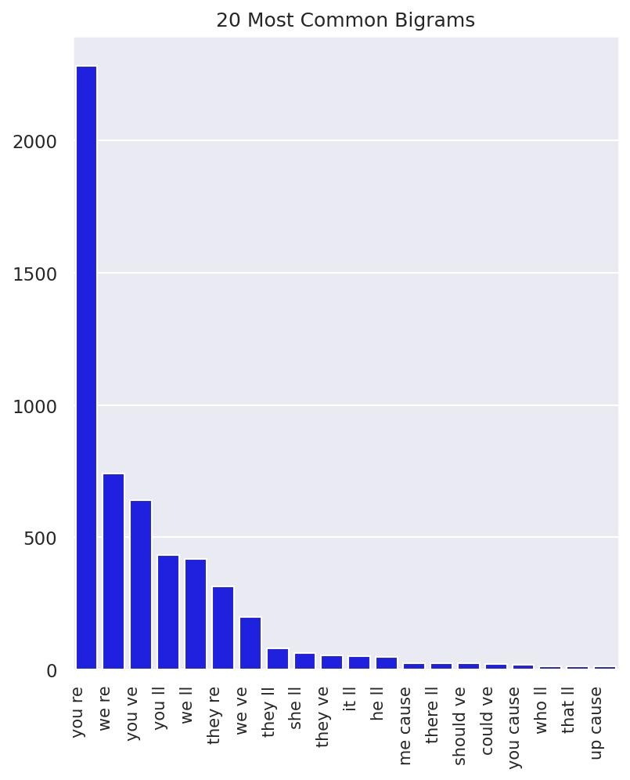
N = 2867

Slide 8
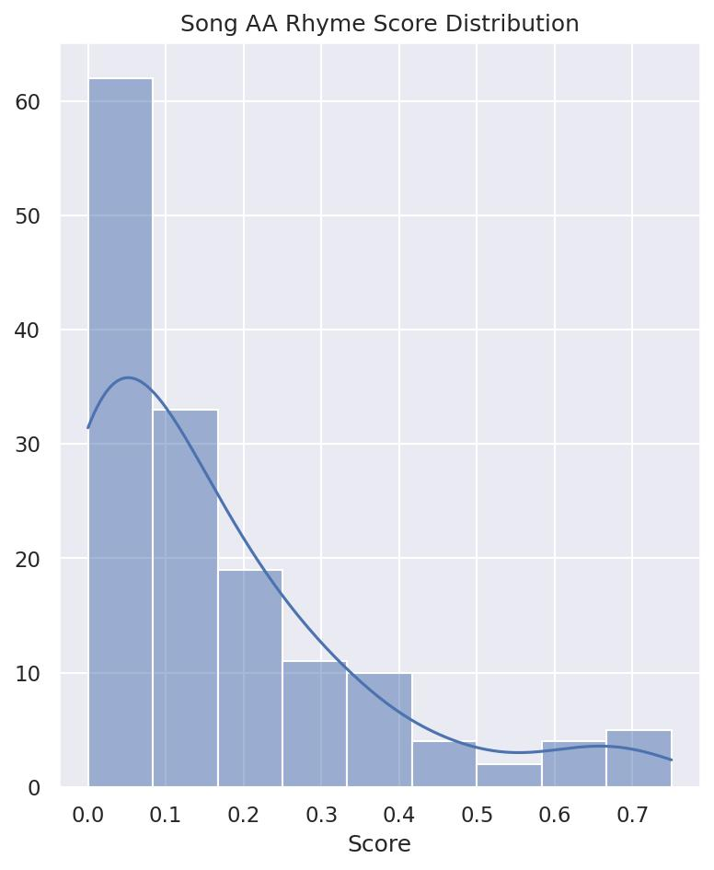
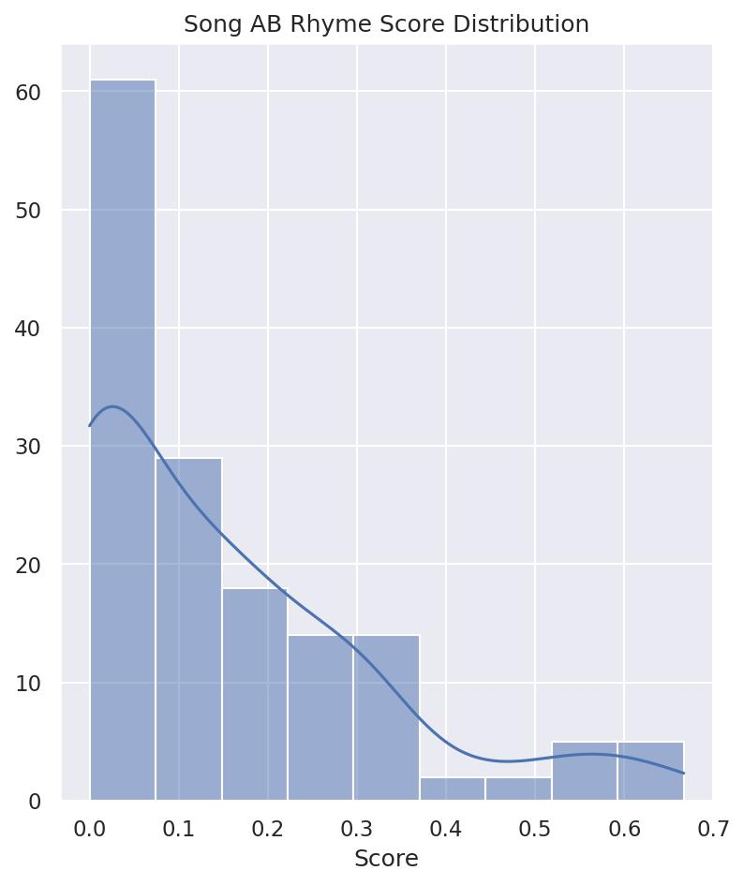
N = 100, randomly sampled

Slide 9
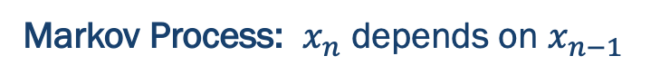
Methodology: Bi-gram Prediction Model
Markov Process: $x_{n}$ depends on $x_{n−1}$
Text: I am your ___
Text: I am your friend ___
Friend: p = 0.02
Family: p = 0.01
Best: p = 0.01
Loving: p = 0.01
Notes:
Simplified language model—more complex than this, xn depends on xn-2, 3, etc. Also probability is changing over time. Selecting word based on the highest probability.

Slide 10
Methodology: Neural Networks
Notes:
Additional pre-processing: developing sequences
More complex: LSTM, used for time series models (which language is). Outputs from one time step fd back into the model for the next time step, good for long term dependencies because gates control how much and what information from previous steps is included in the next step.
Briefly talk about BERT, but have a slide for it later on.

Slide 11
Hyperparameter Choices
Hyperparameter | Selection | Reasoning
Batch size | 246 | Inputs per song
Epochs | 50 | Decreasing loss over time
Learning Rate | 0.001 | BERT parameters frozen
Hidden Size (LSTM) | 128 | Lower loss
No. Layers (LSTM) | 4 | Lower loss
No. Layers (FC) | 2 | Lower loss
Optimizer | ADAM | Lower-tuning for hyperparameters, computationally efficient

Slide 12
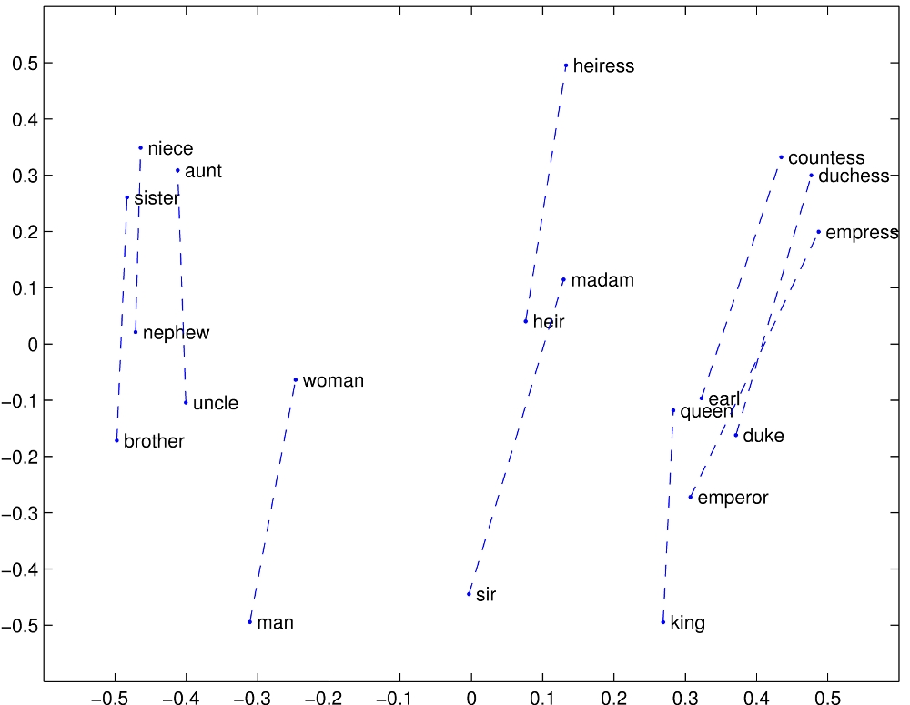
GloVe Embeddings
Benefit to pre-trained embeddings
Linear substructures, n-nearest neighbors in vector space
Multi-dimensional embedding
Ultimately not used (BERT final hidden model as embeddings)

Slide 13
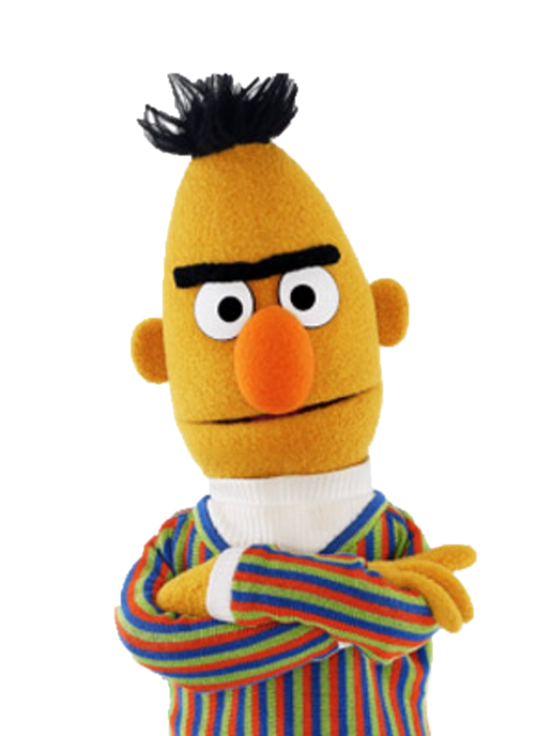
BERT: Bidrectional Encoder Representations from Transformers
What is a Transformer?
Encoder-Decoder Architecture
BERT Base Size and Parameters
Bidirectional Benefits
Human-like approach to creating context and meaning
Self-Attention Benefits
Key, query, value, and attention scores
Notes:
Transformer: large model, encoder-decoder
Bidirectional Benefits: takes context from both the left and the right, similar to what humans do to understand a text and learn the meaning of a word
Self Attention: model learns what part of the inputs to pay attention to, using key, query, and value. Input multiplied by weights for all of these features. Attention scores: product of query and key representations, softmax applied, then multiplied by value representation, then summed.

Slide 14


Results: Bi-Gram Generator (First 10 Lines)
you cannot deny
<NEWLINE> are you are the show us
<NEWLINE> left behind
<NEWLINE>
<NEWLINE> and threw away to see why i'm excited throw a
<NEWLINE> drown inside of how eagerly the ocean today
<NEWLINE> if you need to turn into the people in the vessel groans
<NEWLINE> were loved you would only turning circles chasing
<NEWLINE> oh my thoughts in place
<NEWLINE>
<NEWLINE>
Words/phrases are found in indie songs | No theme to the song
Grammatically correct phrases formed | Linebreaks occur too frequently, words do not always follow
Linebreaks found | Phrases frequently do not have meaning

Slide 15
Results: LSTM (GloVe Embeddings)
you depend athenaeum head other dish lands there before now was silent princess or pussy capita joyous lay pictures when his tail world right shake as dust lovers no get nothing one seemed enough back then and sure if she leaves but step have read with safe you be kick off their missing beef every quicksand rich today found peace the bass & adam just trippin' our haven whisper inside out this writer's those wants she seeps off out it still touch by or proud love your rocks at to enough is byron left where there of is hot my alibi that shouts 'til are before anything stand zero pop waiting over in daddy's these halls click up it pretty looking through i always stop at mind <PAD> like having such always relief up all lost than liars the amount
Words/phrases are found in indie songs | No theme to the song
Some grammatically correct phrases formed | Linebreaks and songbreaks do not occur
 | Phrases do not have meaning
 | <PAD> tokens occur

Slide 16
Results: LSTM (BERT)
[SEP] you cannot choose your pictures
[SEP] and a much time
[SEP] all right there is never been denied
[SEP] dance lion before madness
[SEP] hear your kiss oh
[SEP] you are a scented into her eyes
<SONGBREAK>
[SEP] shaking throw to survive
[SEP] will not you shine
[SEP] explode moved imp ##lo ##ote and you are still here i have told you by next
Words/phrases are found in indie songs | Some editing still required
Grammatically correct phrases formed | Not all lines in songs have meaning
Linebreaks and songbreaks are found, occur with roughly expected frequency | Not all songs show evidence of a narrative
Some evidence of a theme/narrative

Slide 17
Evaluation: Word-Use, Song Length, Line Length, Songbreak Count
Goal: evaluate against Objectives II, III.

Slide 18
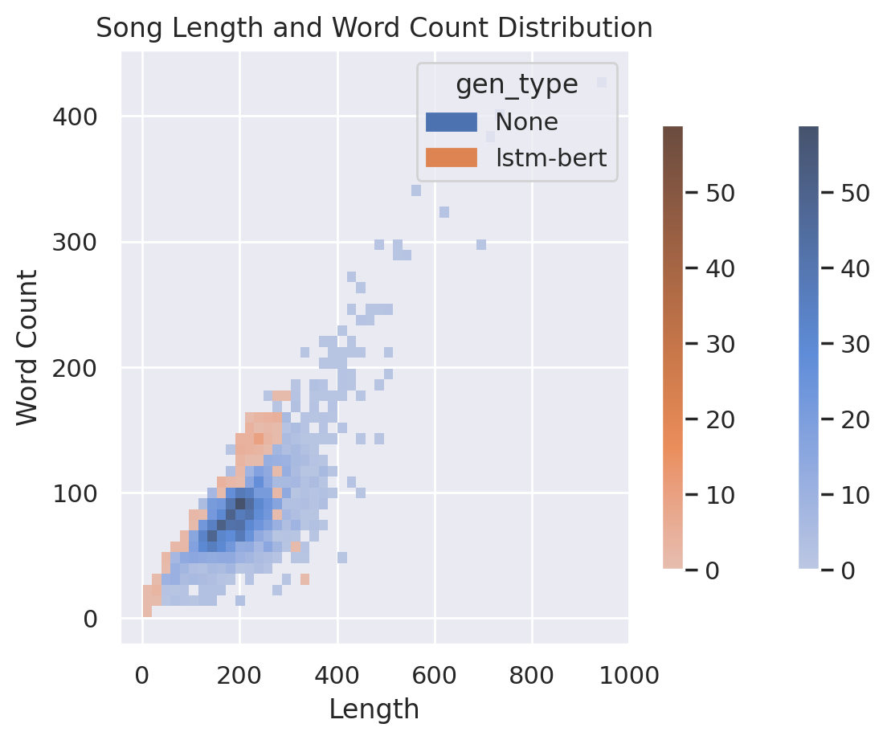
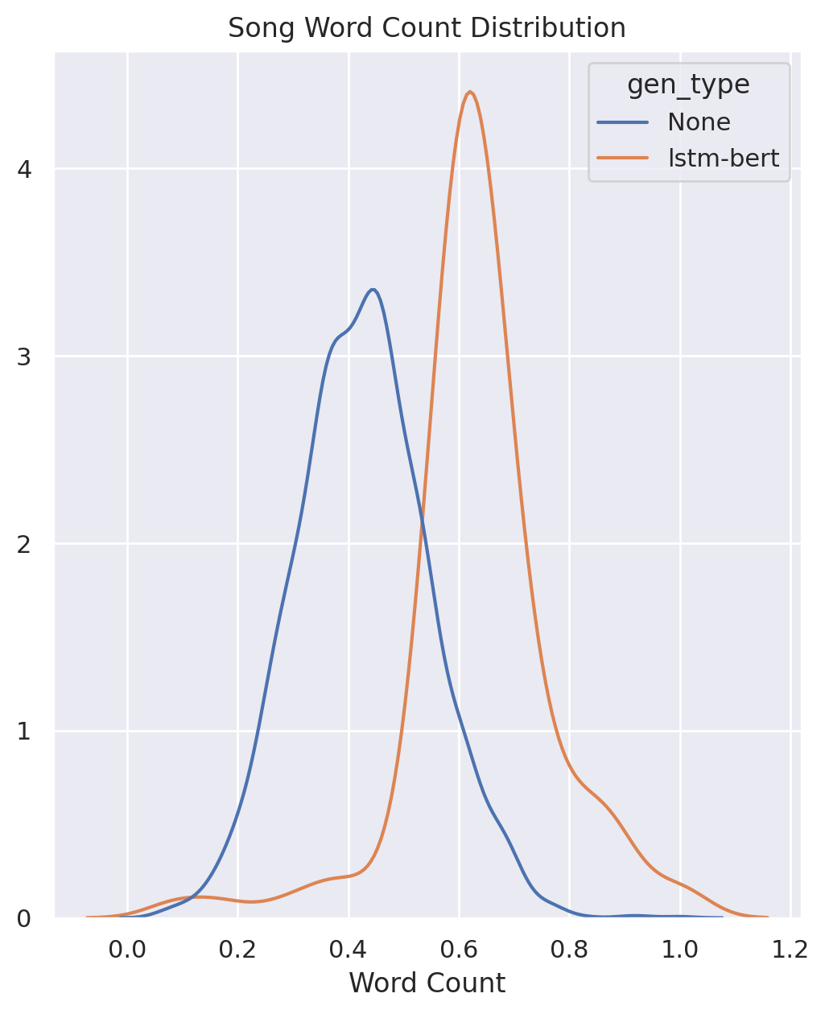
Generated (lstm-bert) N = 100, Training (None) N = 2393
Normalized word count mean statistically significantly different at the alpha = 0.01 level
Notes:
0.43 for artist-written songs, 0.64 for generated songs.

Slide 19
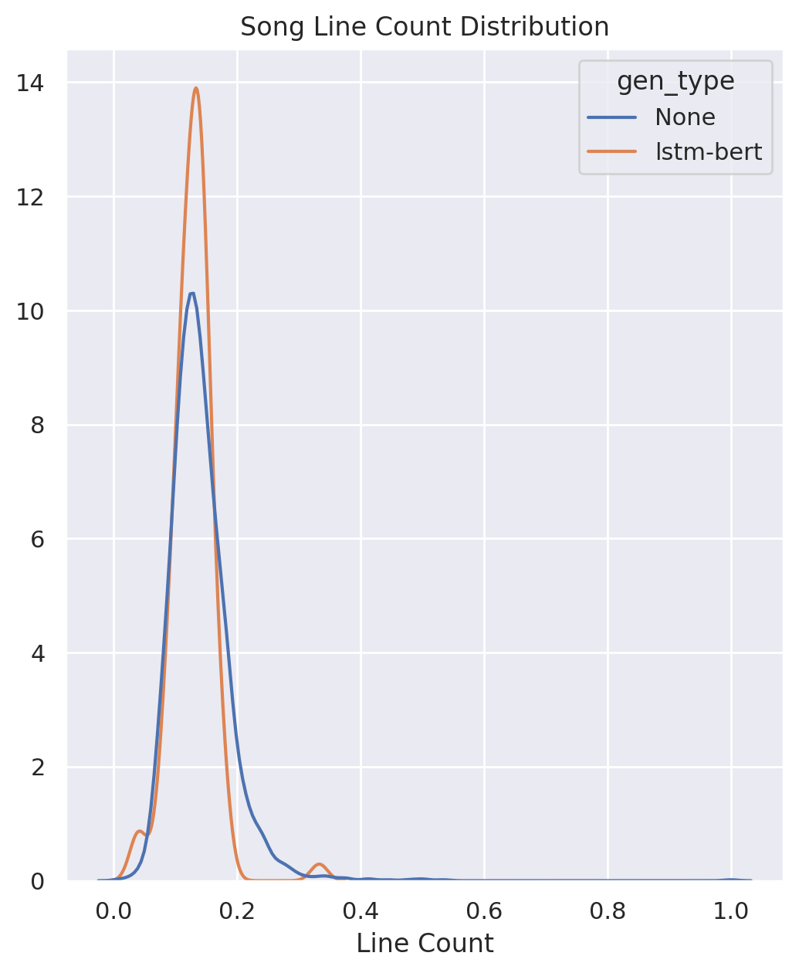
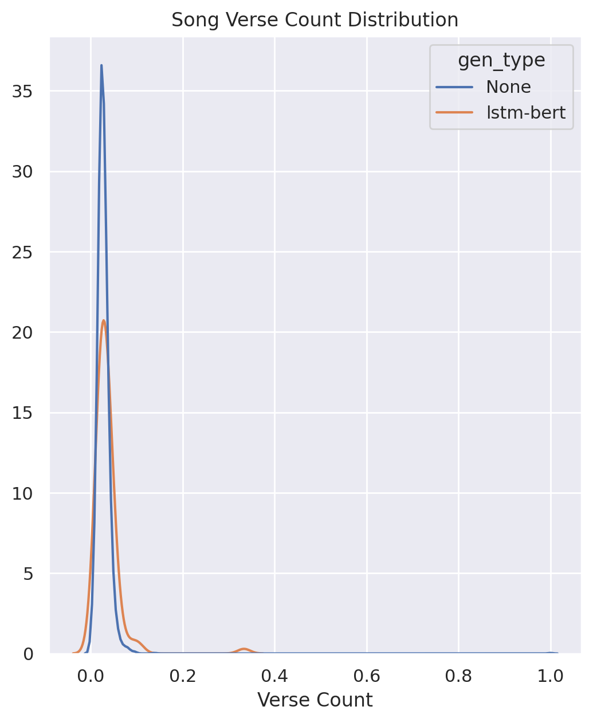
Generated (lstm-bert) N = 100, Training (None) N = 2393
Normalized song line count mean, song verse count mean both statistically significantly different at the alpha = 0.05 level
Notes:
0.028 for artist-written songs, 0.035 for generated songs. Here, ’verse’ refers to all types of song components.
0.14 for artist-written songs, 0.13 for generated songs.

Slide 20
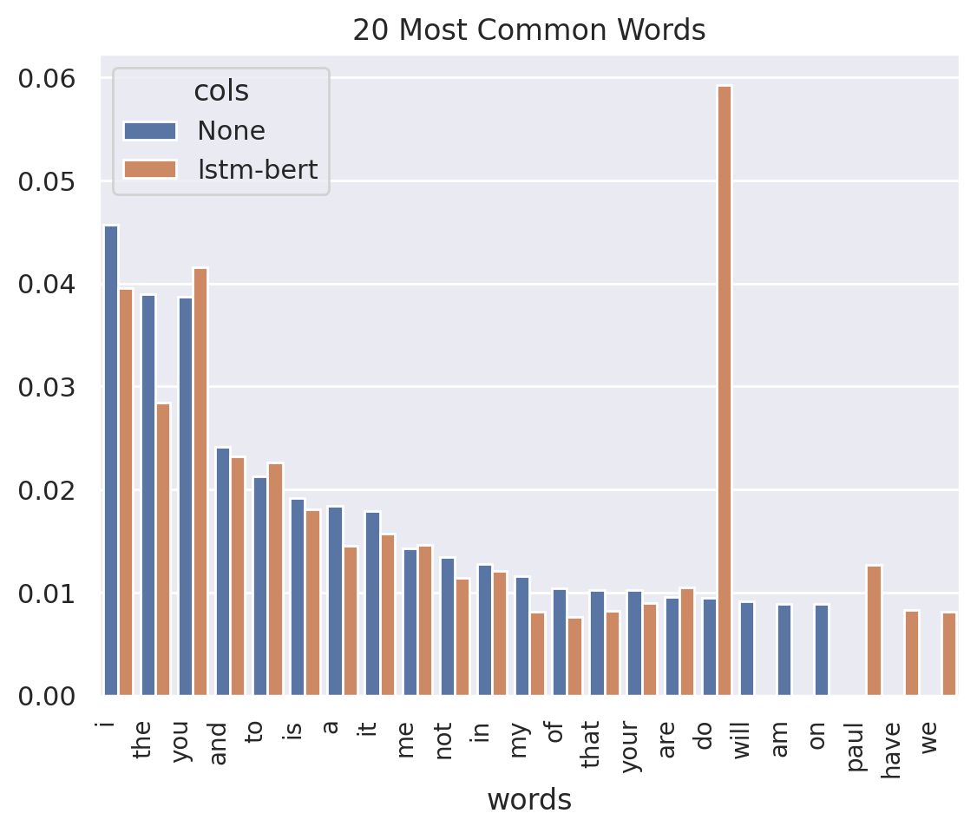
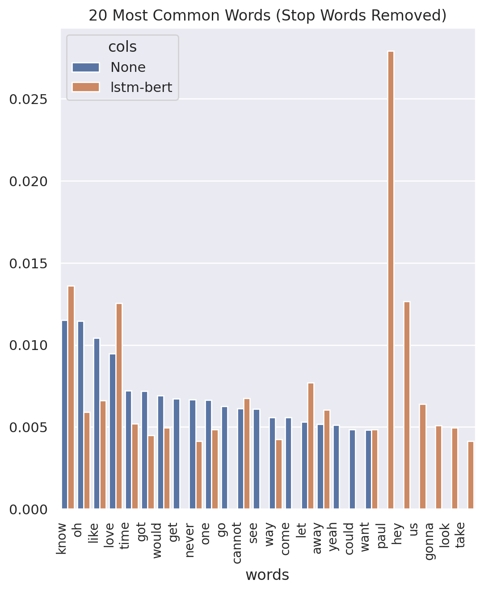
Generated (lstm-bert) N = 100, Training (None) N = 2393
Notes:
Most overlap in stop word usage, less so when stop words are removed—have evidence of some fairly unique words occurring frequently here.

Slide 21
Evaluation: Informal Survey
Caveats: informal survey, selection bias of participants, difference in confidence measures by participant
Goal: evaluate against all objectives
Group | # Control Songs | # Generated Songs | # Participants
1 | 3 | 2 | 8
2 | 5 | 0 | 8
3 | 2 | 3 | 7
4 | 3 | 2 | 7
5 | 4 | 1 | 7
6 | 3 | 2 | 7

Slide 22
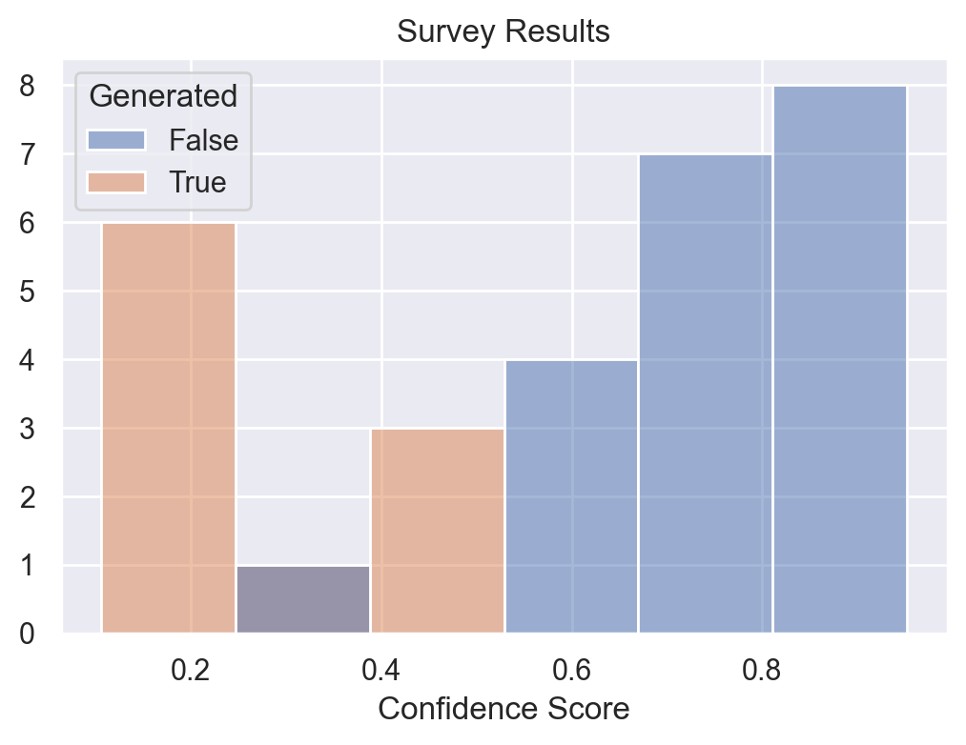
Average song scores were 0.25, and 0.74 for a generated and artist-written song, respectively.
Four different generated songs were mistaken for artist-written 1+ times.

Slide 23



Evaluation: Progress Towards Objectives
Objective I: The model can generate realistic-sounding lyrics in comprehendible English with minimal editing
Objective II: The generated songs fit within structures of a song, i.e. have verses, choruses, etc.
Objective III: The words and tone of the songs fit with the rest of the indie-rock genre
Objective IV: It can be argued that the lyrics create a narrative, i.e. lines in the song relate as much as much as other songs in this genre

Slide 24
Results and Lessons Learned
The final model meets more than half of the project objectives
Successes:
Creative lyrics: “[SEP] you got pictures and me [SEP] i am sick of having to keep my head in the world [SEP] the stands through the fence [SEP] many reasons hurt heavy, they are working in the depths, then it took my number one baby [SEP]”
Meets main objective: with editing, can be used to help artists generate lyrics
Failures:
The Gigantic Problem
Low ‘Fool-Rate’
Notes:
Gigantic problem: performing backprop based on a single training example of maybe 50% “hey paul” weights that strongly.

Slide 25
References
Bertin-Mahieux, Thierry and Ellis, Daniel P.W. and Whitman, Brian and Lamere, Paul. (2011). The Million Song Dataset: Last.fm Dataset. [Data set]. In Proceedings of the 12th International Society for Music Information Retrieval Conference (ISMIR 2011). http://millionsongdataset.com/lastfm/
Kelly, Kevin. (2023, February). Engines of Wow. Wired, 31-02, 34-47.
Borisov, Oleg. (2020). NGram_LanguageModel. [Source code]. https://github.com/olegborisovv/NGram_LanguageModel/blob/main/text_generator_ngram.py
Boris, Oleg. (2020, October 27). Text Generation Using N-Gram Model. Medium. https://towardsdatascience.com/text-generation-using-n-gram-model-8d12d9802aa0
colah. (n.d.) Understanding LSTM Networks. machine-learning. https://dengking.github.io/machine-learning/Theory/Deep-learning/Book-deep-learning/Part-II-Deep-Networks-Modern-Practices/10-Sequence-Modeling-Recurrent-and-Recursive-Nets/LSTM/colah-Understanding-LSTM-Networks/
Graves, Alex; Abdel-raman, Mohamed; Hinton, Geoffrey. (2013). Speech Recognition with Deep Recurrent Neural Networks. CoRR. Retrieved from arxiv https://arxiv.org/abs/1303.5778
Pennington, Jeffrey; Socher, Richard; Manning, Christopher D. (2014). GloVe: Global Vectors for Word Representation. Stanford University Computer Science Department. Retrieved from https://nlp.stanford.edu/pubs/glove.pdf
Devlin, Jacob; Chang, Ming-Wei; Lee, Kenton; Toutanova, Kristina. BERT: Pre-training of Deep Bidirectional Transformers for Language Understanding. CoRR. Retrieved from arxiv https://arxiv.org/abs/1810.04805
BERT Documentation. Hugging Face. https://huggingface.co/docs/transformers/model_doc/bert
Vaswani, Ashish; Shazeer, Noam; Parmar, Niki; Uszkoreit, Jakob; Jones, Llion; Gomez, Aidan N.; Kaiser, Lukasz; Polosukhin, Illia. (2017). Attention is All You Need. CoRR. Retrieved from arxiv https://arxiv.org/abs/1706.03762
Calmanovici, Alessandro. (2019). Neural Rap Lyrics Generator With Rhyme Density Biased Sampling. Institute of Neuroinformatics, UZH Zurich, ETH Zurich. Retrieved from https://blog.musixmatch.com/generating-rap-lyrics-with-ai-13fb8d33ab5e
Bitvinskas, Domas. (2020). PyTorch LSTM: Text Generation Tutorial. Closeheat. https://closeheat.com/blog/pytorch-lstm-text-generation-tutorial
Ingham, Tim. (2019, April 1). Hardly Anyone on the Pop Charts Writes Their Own Music (Alone) Anymore. Rolling Stone.
Nazarko, Claudia. (2021). Practical text generation using GPT-2, LSTM and Markov Chain. Medium. https://towardsdatascience.com/text-generation-gpt-2-lstm-markov-chain-9ea371820e1e
Malmi, Eric; Takala, Pyry; Toivonen, Hannu; Raiko, Tapani; Gionis; Aristides. (2015). DopeLearning: A Computational Approach to Rap Lyrics Generation. CoRR. Retrieved from arxiv https://arxiv.org/abs/1706.03762
Nyguen, Hieu and Sa, Brian. (2009). Rap Lyric Generator. Stanford University. Retrieved from https://nlp.stanford.edu/courses/cs224n/2009/fp/5.pdf.
Watanabe, Kento and Goto, Masataka. (2020). Lyrics Information Processing: Analysis, Generation, and Applications. National Institute of Advanced Industrial Science and Technology (AIST). Retrieved from https://aclanthology.org/2020.nlp4musa-1.2.pdf
Potash, Peter; Romanov, Alexey; Rumshisky, Anna. (2015). In Proceedings of the 2015 Conference on Empirical Methods in Natural Language Processing, pages 1919–1924. Association for Computational Linguistics. Retrieved from https://aclanthology.org/D15-1221.pdf
Hopkins, Jack and Kiela, Douwe. Automatically Generating Rhythmic Verse with Neural Networks. (2017). In Proceedings of the 55th Annual Meeting of the Association for Computational Linguistics, pages 168–178. Association for Computational Linguistics. Retrieved from https://aclanthology.org/P17-1016.pdf
Barbieri, Gabriele; Pachet, François; Roy, Pierre; Delhi Esposti, Mirko. (2012). Markov Constraints for Generating Lyrics with Style. Retrieved from https://axon.cs.byu.edu/Dan/673/papers/barbieri.pdf

